Slide 1


Slide 2

CAPSTONE PROJECT TITLE: Customer Churn Analysis.
Presented by :- PALLAVI MOHANTY

Slide 3


PROJECT CONTENT
Introduction and Problem Statement
Data Loading
Data Exploring
Data Cleaning
IV.1. Binning
Data Visualization
V.1. Univariate Analysis
V.2. Bivariate Analysis
Feature Engineering
Data Preprocessing
Train – Test Split
Feature Scaling
Smoteenn
Model Building and Evaluation
Model Comparison
CUSTOMER CHURN

Slide 4
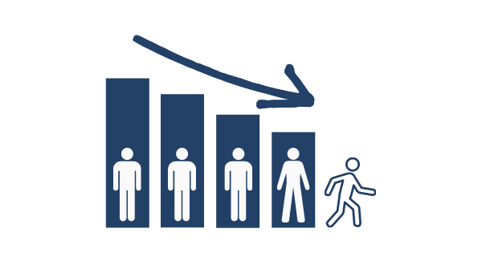
I. INTRODUCTION
Q. What is Customer Churn?
Customer churn is defined as when customers or subscribers discontinue doing business with a firm or service
Each row represents a customer, each column contains customer’s attributes described on the column Metadata.
The data set includes information about:
Customers who left within the last month – the column is called Churn .
Services that each customer has signed up for – phone, multiple lines, internet, online security, online backup, device protection, tech support, and streaming TV and movies.
Customer account information – how long they’ve been a customer, contract, payment method, paperless billing, monthly charges, and total charges.
Demographic information about customers – Customer ID, gender, and if they have partners and dependents.
THIS IS A CLASSIC TELECOM CHURN USECASE.

Slide 5

PROBLEM STATEMENT
The target variable Telco Churn dataset typically revolves around predicting customer churn. It has only two possible outcomes: churn or not churn (Binary Classification). "Churn" refers to the scenario where customers who are likely to cancel their contracts soon. In the telecom industry, customer churn can be a significant issue, as it can lead to revenue loss. If the company can predict that, it can handle users before churn.

Slide 6
APPROACH TO SOLVE PROBLEM STATEMENT
Exploratory Data Analysis (EDA) to understand data patterns and relationships.
Data preprocessing, including handling missing values, encoding categorical variables, and feature scaling.
Splitting the dataset into training and testing sets.
Building and training machine learning models for churn prediction.
Evaluating model performance using metrics like accuracy, precision, recall, and F1-score.
Good accuracy model is chosen.
Providing recommendations based on model insights.
The ultimate goal is to help the telecom company proactively identify customers at risk of leaving, allowing them to implement targeted retention strategies and improve customer satisfaction.

Slide 7
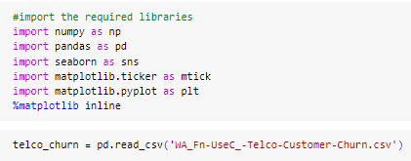
II. DATA LOADING
Importing the necessary libraries for data analysis and visualization, ensuring that visualizations are displayed inline.
Reading a CSV file located at the specified path and assigning it to a pandas DataFrame called ‘telco_churn’ for further analysis.
It is commonly used at the beginning of a data analysis and machine learning project to set up the environment, loading the dataset, and preparing for exploration and visualization. It is particularly useful for interactive data analysis.

Slide 8
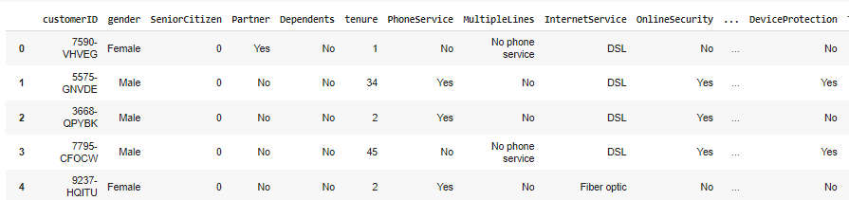
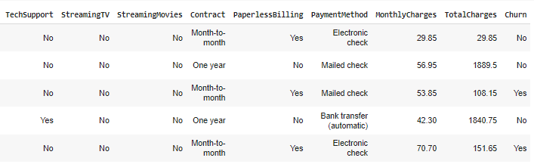
Displaying dataset of “telco_churn”

Slide 9
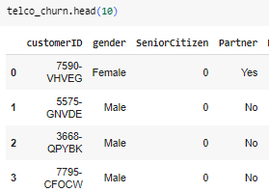
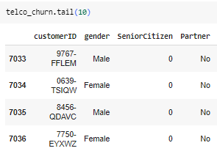
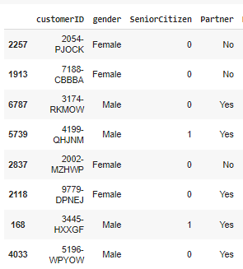

III. DATA EXPLORING
The primary goals is to uncover patterns, relationships, anomalies, and insights that can inform subsequent analysis.
Looking at the dataset by using head( ), tail( ), sample( ), size( )

Slide 10
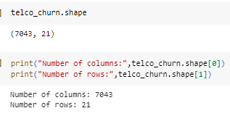
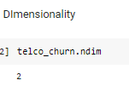
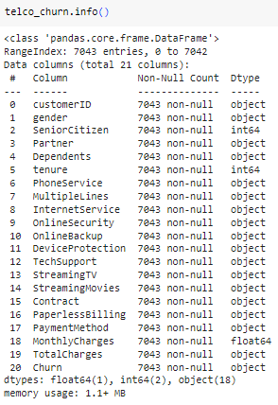
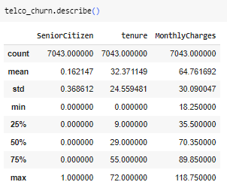
Checking the various attributes of dataset like Shape (Total number of Rows and Columns), Columns name, Datatypes of columns, Dimensionality, Information(Memory size, Datatypes, NAN values), Describe(Min,Max,Median,25 %,75 %,and so on...)
describe() method is useful for quickly understanding the
distribution and central tendency of your numerical data.
We can see that the TotalCharges is in numerical form but its datatype shown as object.

Slide 11
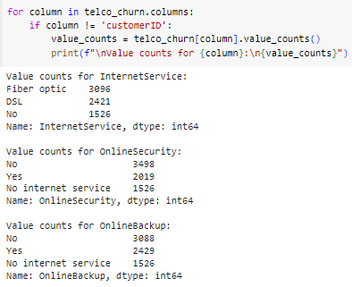
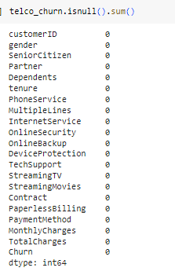
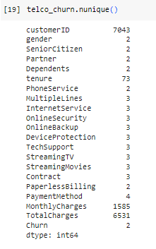
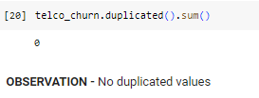
Checking value_counts(), nunique(), Duplicated().sum() ,isnull().sum()
nunique() - Returning a series object that displays the count of unique values of each columns
OBSERVATION - There is no missing values in the above dataset
OBSERVATION - In all the above shows that,
there was no column with name issue but
No internet service and No phone service
means the same as 'NO

Slide 12
OBSERVATION
The TotalCharges should be float or int but it is object so their might be some missing values in this columns i.e we need to change it into float or int.
As There are whites spaces in the TotalCharges Column therefore we cannot see the missing values.
In SeniorCitizen columns, It is actually a categorical, hence the 25%-50%-75% distribution is not proper.
In MonthlyCharges columns,Average Monthly charges are USD 64.76 whereas 75% customers pay more than USD 89.85 per month.
No duplicated values.

Slide 13



IV. DATA CLEANING
Creating a copy of telco_churn for manipulation & processing. So, there is no data leakage.
Churn Column (Target Column)
Converting churn column a Categorical value to Numerical Value

Slide 14
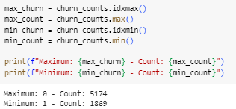

Displaying values of maximum and minimum
Finding the percentage of the Churn Column
OBSERVATION -
Data is highly Imbalanced, ratio = 73:27
So we analyze the data with other features while taking the target values
separately to get some insights.

Slide 15
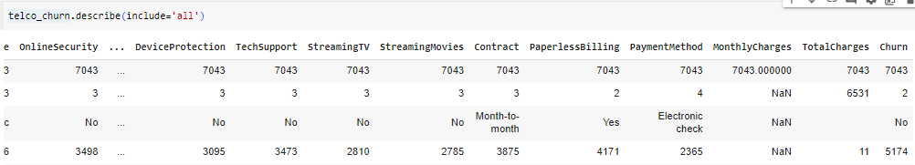
TotalCharges Column
Total Charges should be numeric amount. Converting it to numerical data type.
OBSERVATION -
top: " " (the most frequent value in the "Totalcharges" column is
white spaces)
freq: 11 (the count of " " occurrences in the "TotalCharges" column

Slide 16

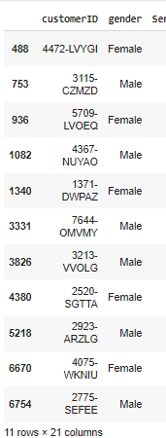

Here we will be filling the white spaces with NAN values.
Calculating the percentage of NAN values with respect to the total number of rows.
As we can see there are 11 missing
values in TotalCharges column.
Let's check its records
OSERVATION - Since the % of these records compared to total dataset is very low i.e 0.16%, it is safe to fill them with 0 for further processing.

Slide 17
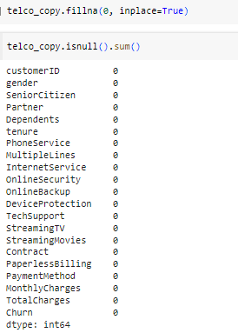

Missing Value Treatment
Checking the data type of the 'TotalCharges' column
OBSERVATION – Now treating the missing
values with 0 value. There is no missing
value left

Slide 18
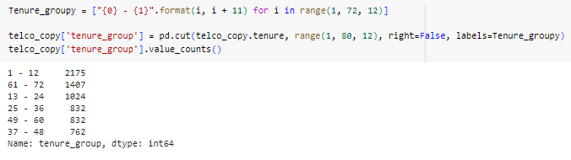

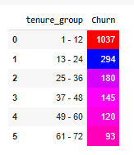

IV.1. BINNING
4. Tenure Column
Dividing customers into bins based on tenure. for e.g. for tenure < 12 months: assign a tenure group if 1-12, for tenure between 1 to 2 Years, tenure group of 13-24; so on... (i.e - Grouping the tenure in bins of 12 months)
Dropping tenure column as we
already created a tenure_group.

Slide 19
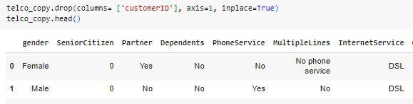
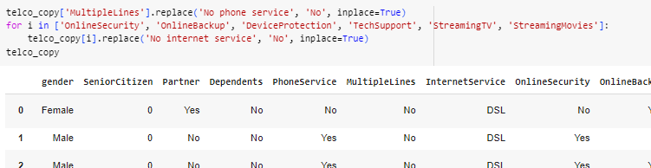
Customer-ID Column
Modifying Column
'No internet service' and 'No phone service' are not different from No and can be replaced with "No"

Slide 20

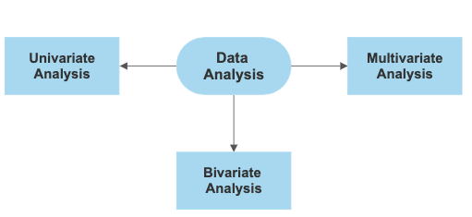
V. DATA VISUALIZATION
Data visualization is the representation of data in graphical or visual formats to communicate information effectively. It involves using charts, graphs, maps, and other visual elements to convey patterns, trends, and insights present in the data. It is a powerful tool for exploring, interpreting, and presenting data in a way that is easily understandable.
Types of Data Visualization:
Univariate Analysis: Univariate analysis involves the examination of a single variable or feature in isolation.
Bivariate Analysis: Bivariate analysis helps uncover patterns, correlations, and dependencies between two variables.

Slide 21
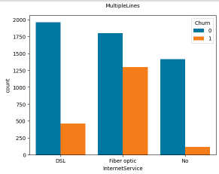
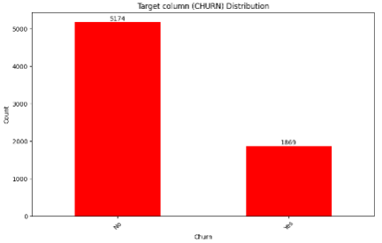
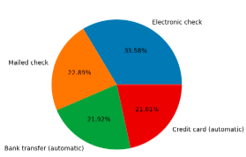
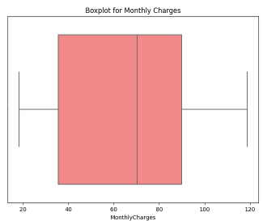
V.1. UNIVARIATE ANALYSIS
1.
2.
OBSERVATIION - Customers with Fiber optic Internet service type has churned more DSL is the most popular internet service type.
OBSERVATION -Maximum Customers has not churned i.e No-5174 & Less number of Customers has churned i.e Yes-1869
3.
4.
OBSERVATION - Electronic check is 33.58% that is
more than other payment method
OBSERVATION - Very less outliers in MonthlyCharges

Slide 22
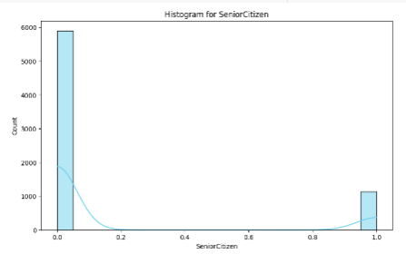
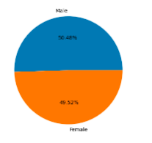
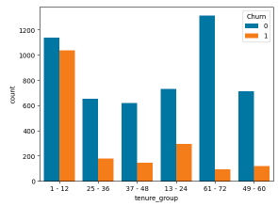
5.
7.
OBSERVATION - The distribution appears to be right-skewed, with a
longer tail on the right side. This indicates that there are fewer
senior citizens in the dataset.
6.
OBSERVATIION –Customers with 1-12 tenure_group has churned more
OBSERVATION - Male has 50.48 % and Female has 49.52%

Slide 23
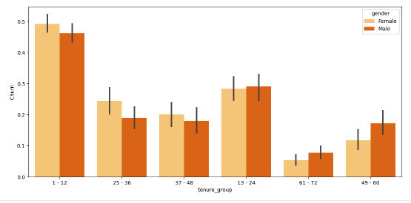
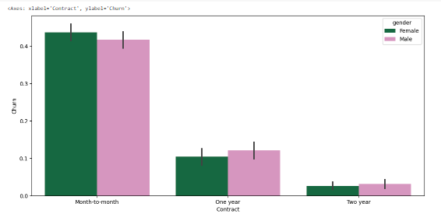
V.2. BIVARIATE ANALYSIS
1.
2.
OBSERVATION - Tenure_group from Female Category within 12 month (i.e 1 year) has churned highly
OBSERVATION – ’Month-to-month' contract has a significantly higher bar, it suggests a higher churn rate for customers mostly in gender female Because of no contract terms, as they are free to go

Slide 24
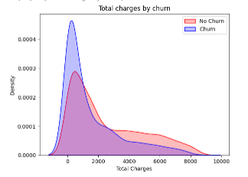
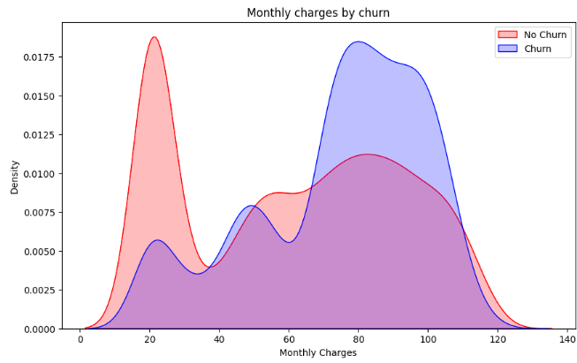
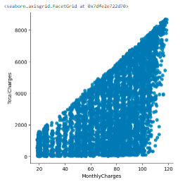
3.
4.
OBSERVATION - Surprising insight as higher Churn at lower Total Charges
OBSERVATION - Churn is high when Monthly Charges are high
5.
OBSERVATION - Total Charges increase as Monthly Charges increase as expected

Slide 25
CONCLUSION FOR DATA VISUALIZATION
Tenure_group within 12 month (i.e 1 year) and Non senior Citizens from female category has churned highly.
'Month-to-month' contract has a higher churn rate for customers mostly in gender female. Because of no contract terms, as they are free to go customers.
Churn is high when Monthly Charges are high and Total Charges is low but we see that between Total and Monthly charges when Total Charges increase also Monthly Charges increases as well.
Less number of Customers has churned i.e Yes - Count: 1869. Therefore Data is highly Imbalanced in ratio = 73:27.
Electronic check is 33.58% as it is the most common payment method of churning more customers.
The gender distribution is roughly balanced.
Customers with Fiber optic Internet service type has churned more DSL is the most popular internet service type.
PhoneServices and Paperless billing customer that is chosen by a significant number of customers has churned is less and not churned is more.

Slide 26

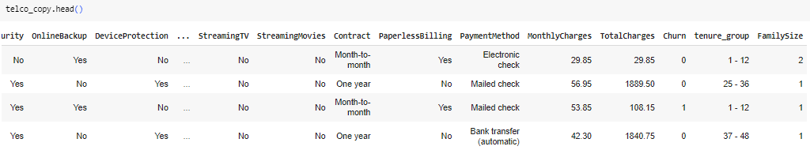
VI. FEATURE ENGINEERING
1.Creating Binary Features: Converting categorical features like 'Partner', 'Dependents' into binary features (0 or 1).
2. Creating a Feature for Family Size: Combining information from 'Partner' and 'Dependents' to create a feature representing the size of the customer's family.

Slide 27
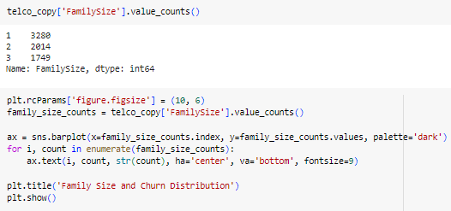
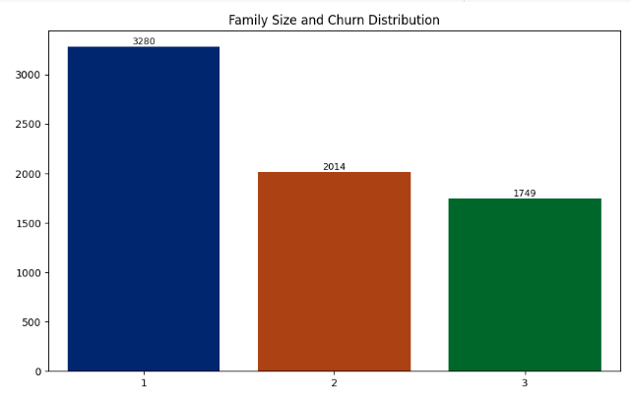
3. Creating a plot : To see which family size has churned more.

Slide 28
VII. DATA PREPROCESSING
The goal of data preprocessing is to enhance the quality of the data, remove any inconsistencies or errors, and prepare it for further analysis or modeling.
Two Techniques of Feature Encoding are:
One-Hot Encoding - One-hot encoding is a method used to convert categorical variables into a binary matrix (0s and 1s).
Label Encoding - Label encoding is another technique for converting categorical data into a numerical format.
FEATURE ENCODING
One-Hot Encoding
Label Encoding

Slide 29

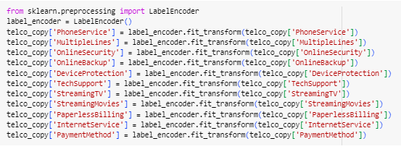
1. One-Hot Encoding
2. Label Encoding

Slide 30
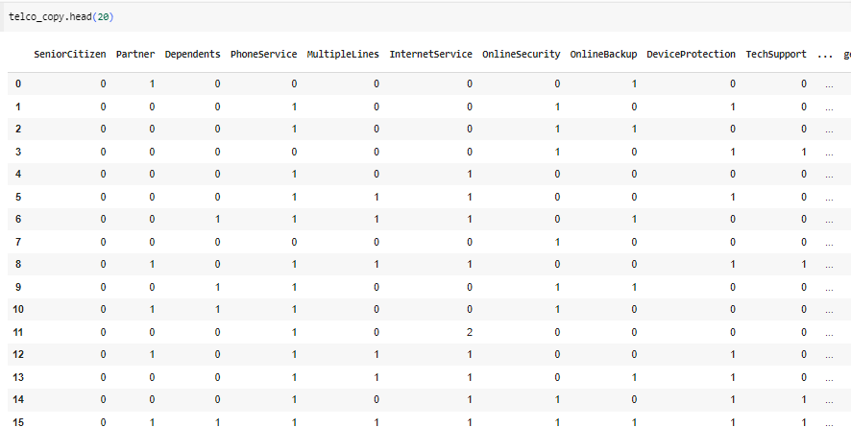
Data Displayed

Slide 31
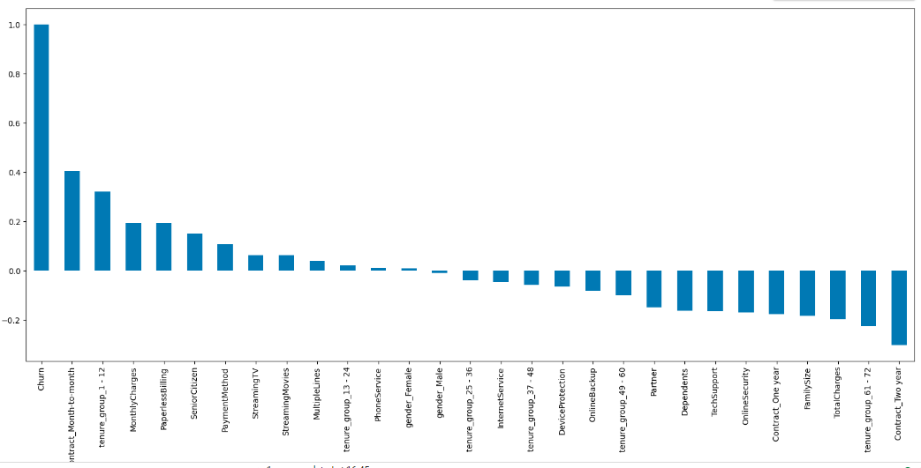
IDENTIFYING BEST FEATURE
4. Correlation of the features with 'Churn‘
This ‘Month-to-Month Contract‘ feature has the greatest influence among all features

Slide 32
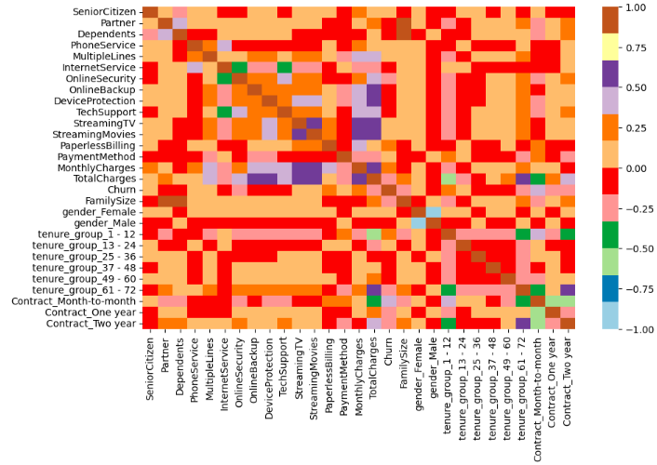
MULTIVARIATE ANALYSIS
5. using HEATMAP, Correlation of the features with 'Churn‘ .
OBSERVATION -
HIGH Churn seen in case of Month to month contracts.
LOW Churn is seen in case of Long term contracts
Factors like Gender, Availability of PhoneService and Number of multiple lines have almost NO impact on Churn.

Slide 33

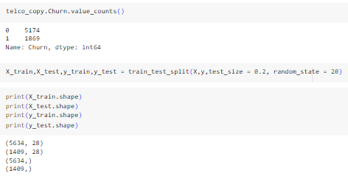
VIII. TRAIN – TEST SPLIT
This code randomly splits the dataset X (features) and y (labels) into two separate sets: the training set (X_train and y_train) and the testing set (X_test and y_test). The split is done with a test size of 0.2, meaning that 20% of the data will be allocated for testing, while the remaining 80% will be used for training. The random_state parameter is set to ensure reproducibility of the split.
1. Splitting the telco_copy into X and y and then doing Train-Test Split.

Slide 34

IX. FEATURE SCALING
Scaling is performed to ensure that all numerical features in a dataset are on a similar scale, avoiding biases, enabling fair comparisons, and facilitating the convergence. It is a technique used in machine learning to standardize or normalize the range of independent variables or features of the dataset.
Methods of feature scaling
Standardization (Z-score Normalization):This code is an implementation of the standardization (Z-score normalization) method for feature scaling. Standardization scales the features so that they have a mean of 0 and a standard deviation of 1.

Slide 35


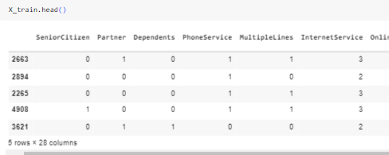
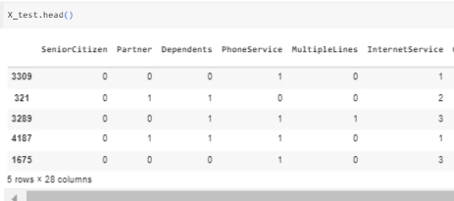
1. Standard Scaling Analysis
Scaling the numerical features
Extracting numerical features for scaling
2. Fitting and transforming the training data, saving the scaling parameters for future use in test data.
Display the scaled training and test sets

Slide 36
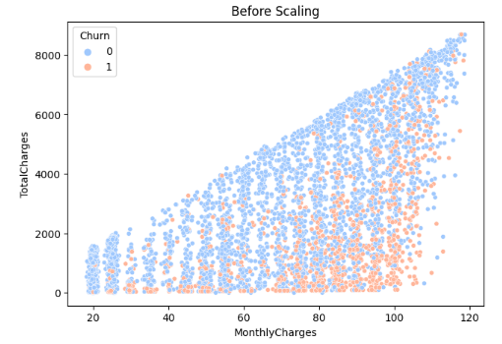
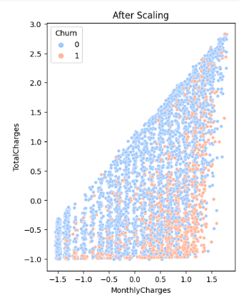
2. After Scaling
on Numerical_Features
Before Scaling on Numerical_features

Slide 37

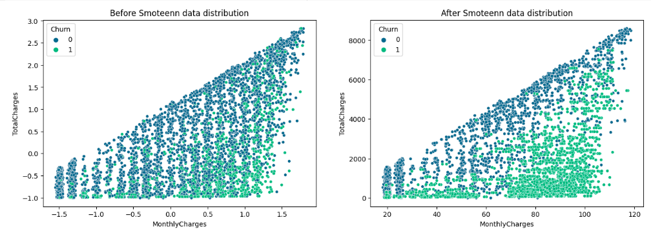
X. SMOTEENN
SMOTEENN is used to address imbalanced datasets by generating synthetic examples for the minority class (SMOTE) and cleaning the dataset to remove noise (ENN), ultimately leading to a more balanced and representative dataset for model training. For instance, in a binary classification problem, one class may have significantly fewer instances than the other.

Slide 38
XI. MODEL BUILDING & EVALUATION
Random Forest
K-Nearest Neighbors Classifier (KNN)
MODEL
Support Vector Classifier (SVC)
Decision Tree
XGBoost Classifier

Slide 39
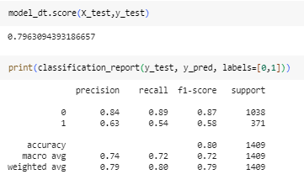


In Imbalanced data accuracy is cursed.
As you can see that the accuracy is quite low, and as it's an imbalanced dataset. Hence, we need to check recall, precision & f1 score for the minority class, and it's quite evident that the precision, recall & f1 score is too low for Class 1, i.e. churned customers. Hence, moving ahead to call SMOTEENN (OverSampling + ENN)
After using SMOTEENN

Slide 40

XII. MODEL COMPARISON

Slide 41

CONCLUSION OF MODEL COMPARISON
After evaluating different models for Churn detection, including Decision Tree, Random Forest, K-Nearest Neighbors, Naïve Baye’s, XGBoost and SVC, it can be concluded that the XGBoost model achieved the highest accuracy among the evaluated models, with an accuracy score of 0.9689. XGBoost model is an ensemble learning method that combines the predictions of multiple weak learners (typically decision trees) to create a strong learner. This helps capture complex relationships in the data.
The key importance lies in its ability to handle complex relationships in data, prevent overfitting, handle missing values, and provide flexibility and customization for various machine learning tasks.
Combining XGBoost with SMOTEENN may enhance the model's performance on imbalanced datasets. It helps the model better capture patterns in the minority class by oversampling and cleaning the dataset.

Slide 42

The best model is the XGBoost Classifier with highest accuracy score of 0.9689

Slide 43

Looking for maximum and minimum Models name with Accuracy score

Slide 44
OVERALL CONCLUSION
As MonthlyCharges increases also TotalCharges Increases.
Customers with 'Month-to-month' contract has a higher churn rate. Because of no contract terms, as they are free to go customers.
Churn is high when Monthly Charges are high and Total Charges is low
Electronic check is the most common payment method of churning more customers.
Customers with Fiber optic Internet service type has churned more DSL is the most popular internet service type.
PhoneServices and Paperless billing customer that is chosen by a significant number of customers has churned very less.
XGBoost model achieved the highest accuracy among the evaluated models.

Slide 45

DASHBOARD

Slide 46

THANK YOU

